Slide 1
Video Game From 1980-2022
Yushu Gong
Ziqiao zhang

Slide 2
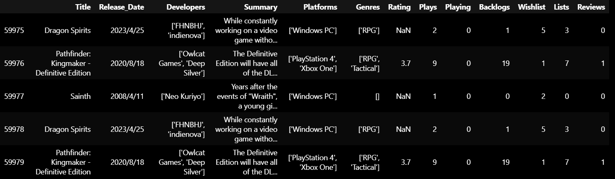
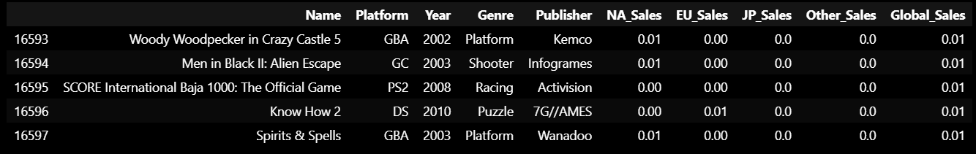
the research questions, motivation
Descriptive Analysis:
Research Question:
Main Data Set:
Identify the popular genres, platforms, and developers in the gaming industry.
Examine the gaming trends spanning the past 40 years (1980-2022), focusing on genres and platforms.
Sales Data Set:
Explore the popularity of game genres across different regions.
What is the recent trend for the popular game genres, platform?
What is the correlation among game playing, backlogs, wishlist, lists, reviews? (Significant analysis)
Build predictive model: Using game playing, backlogs, wishlist, lists, reviews to predict the game rating.
Notes:
In this presentation, we delve into two key inquiries:
Key Takeaways:
Comprehensive understanding of the current gaming landscape.
Insights into the historical and regional preferences in game genres.
Predictive model to guide future decisions.
Statistical significance of game ratings on player engagement.
Null hypothesis (H0): There is no significant correlation between the number of times a game has been mentioned in a game list and the game entering the user's wishlist.
Alternative Hypothesis (H1): There is a significant correlation between the number of times a game has been mentioned in a game list and the game's entry into the user's wishlist.

Slide 3
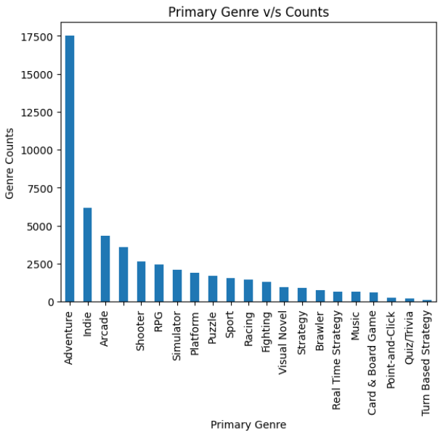
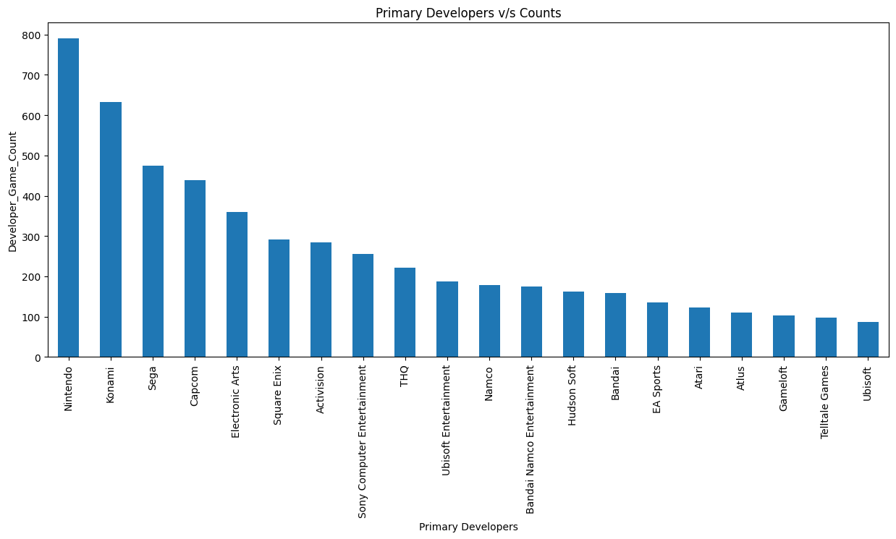
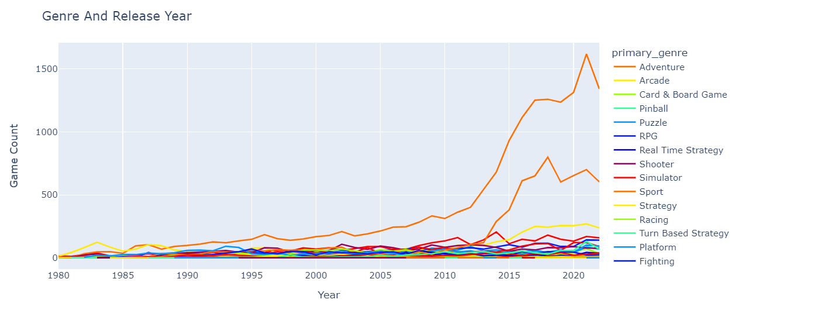
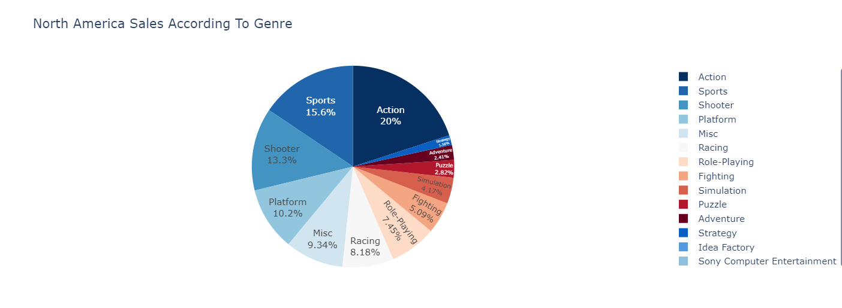
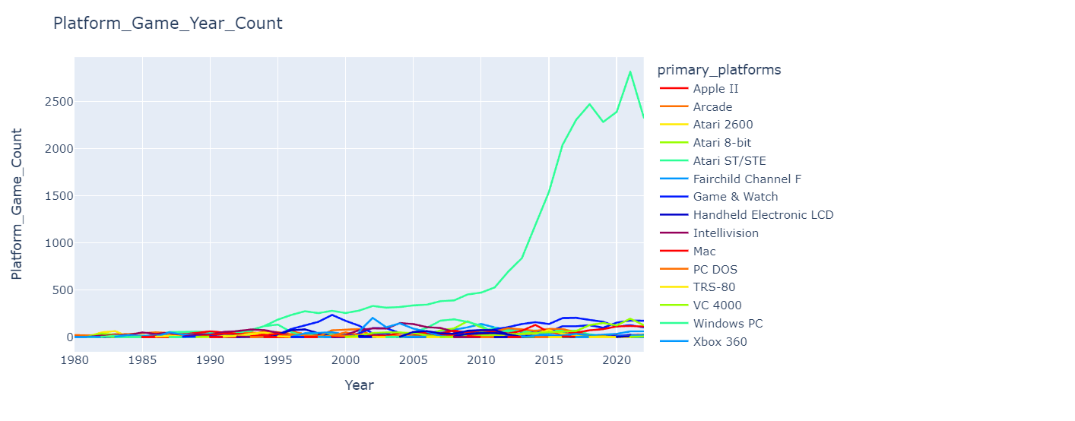
data presentation
Notes:
SALE
Popular game: descriptive: area chart
On hot platform/genre---correlation(heatmap)----regression

Slide 4
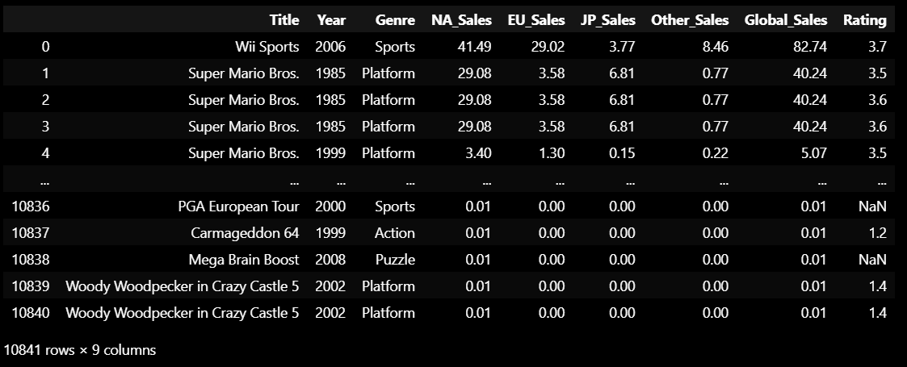
progress, questions, issues
We are almost manage the descriptive part of the dataset, know the general information about the game. And the basic trend of the genres during the last fourty years.
The problem: To build the prediction model and conduct significant analysis.
If we use this dataset we can build the predict model based on the rating to predict the sales (separated by regions). ---- Maybe more meaningful?

Slide 5
Thanks for listening

